Slide 1


Predictive Model for Heart failure Detection
B.TECH 2022-26 5TH SEM MINOR PROJECT-I
BACHELOR OF TECHNOLOGY DEPARTMENT OF COMPUTER SCIENCE & ENGINEERING SCHOOL OF ENGINEERING AND TECHNOLOGY GANDHI INSTITUTE OF ENGINEERING & TECHNOLOGY UNIVERSITY, GUNUPUR- 765022, ODISHA AUGUST 2024

Slide 2
PROJECT PRESENTED BY :
ABINASH BHARAT JYOTI RATHA 22CSE080
RAJAT KUMAR DASH 22CSE139
SOUMYA RANJAN MOHAPATRA 22CSE215

Slide 3
TABLE OF CONTENT
Introduction
Hardware and Software Requirements
Dataset
Data Preprocessing
Model Selection
Flow chart
Evaluation Metrics
Screenshot
Future Work
Conclusion

Slide 4
INTRODUCTION
Heart failure is a serious medical condition where the heart is unable to pump blood effectively, leading to a range of health complications. Early prediction of heart failure is crucial, as it can significantly improve patient outcomes by enabling timely intervention and treatment.
The goal of this project is to develop a machine learning model capable of predicting the likelihood of heart failure based on patient data. By aiding in early diagnosis, this model can help healthcare providers identify high-risk patients before symptoms become severe, facilitating prompt and effective care.

Slide 5
HARDWARE & SOFTWARE REQUIREMENTS
Hardware Requirements:
Laptop equipped with at least 8GB of RAM and 500 GB of storage.
Operating System : Windows.
Software Requirements:
Development Environment-Python IDE(e.g. VS Code)
Language:-Python
Libraries:-Pandas, NumPy, Scikit-learn, Matplotlib, Seaborn
.

Slide 6
DATASET
Source: The dataset used for this project was sourced from ‘Kaggle’
which provides comprehensive information on patient health.
Features:
Age
Sex
ChestPainType
RestingBP
Cholesterol
FastingBS
RestingECG
MaxHR
ExerciseAngina
Oldpeak
ST Slope
HeartFailure

Slide 7
DATA PREPROCESSING
Handling Missing Values: Missing data was handled using imputation techniques to ensure completeness
Feature Scaling: Numerical features were scaled using StandardScaler to standardize the data and improve model performance
Encoding Categorical Variables: Categorical features were encoded to convert them into numerical values

Slide 8
MODEL SELECTION
Models Used:
Logistic Regression: A linear model for binary classification
Decision Trees: A model that splits data into branches to make predictions
Random Forest: An ensemble of decision trees to improve prediction accuracy
KNN Classifier: A non linear model for binary classification

Slide 9
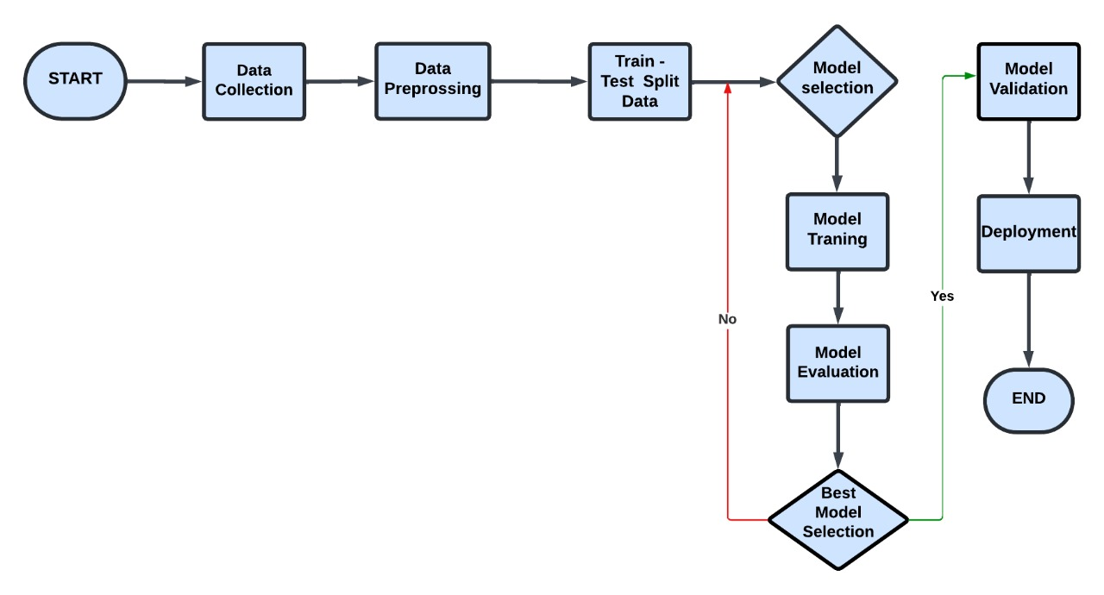
FLOW CHART

Slide 10
EVALUATION METRICS
Metrics Used:
Accuracy: The proportion of correctly predicted instances
Precision: The proportion of true positive results out of all positive predictions
Recall: The proportion of true positive results out of all actual positives
F1 Score: The harmonic mean of precision and recall
Confusion Matrix: It shows the true positives, false positives, true negatives and false negatives.
Results:
Best Accuracy: 92%
Mean Accuracy: 86.17%

Slide 11
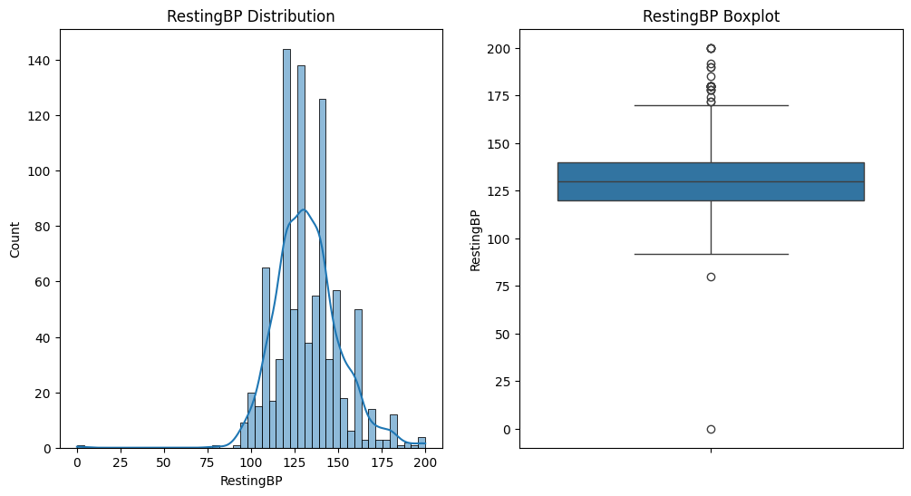
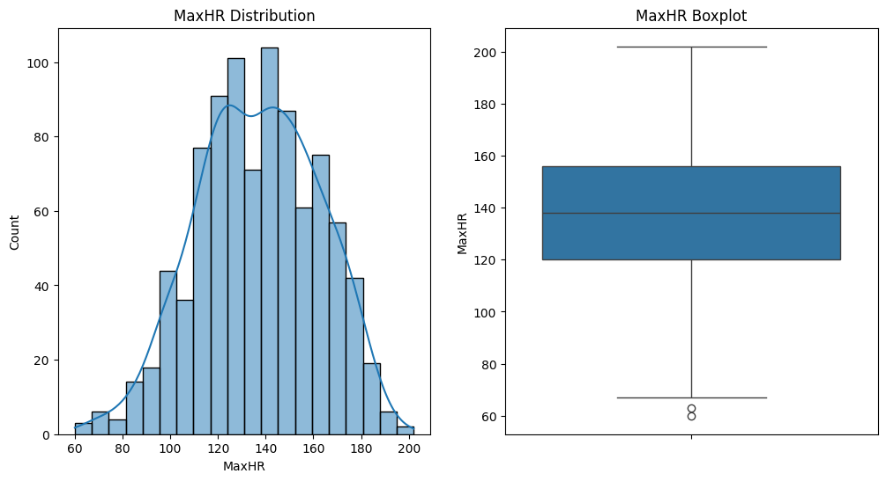
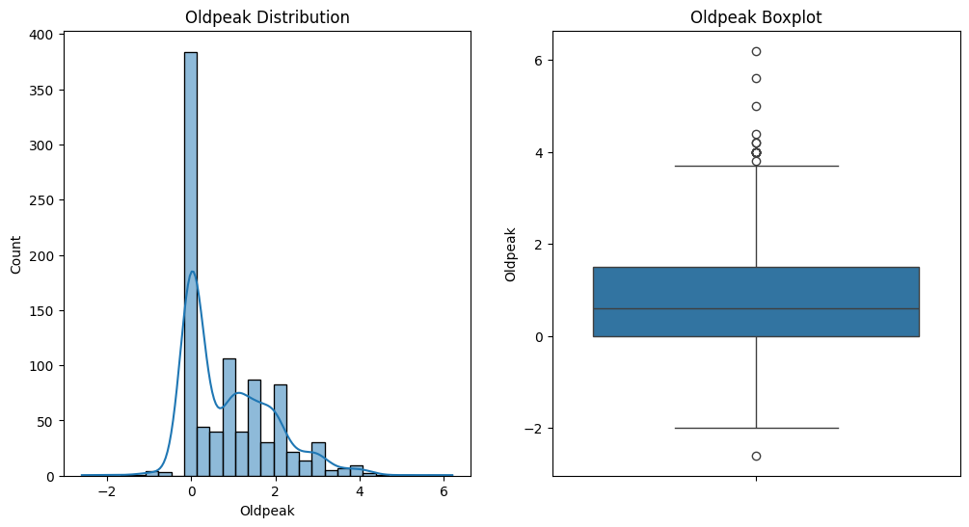
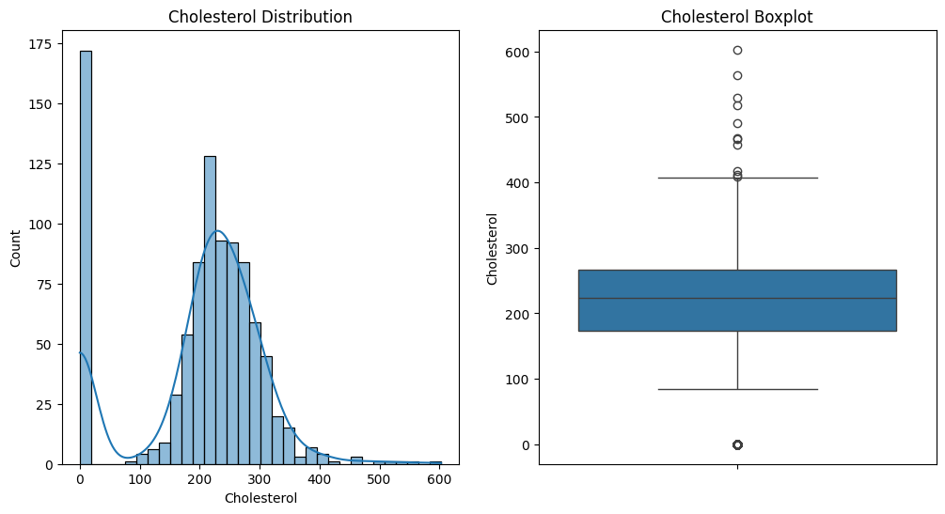
Screenshot

Slide 12
Future Work
Model Optimization: Explore advanced hyperparameter tuning techniques to further refine the model.
Dimensionality Reduction: This is a specific technique used to simplify the model by reducing the number of features while retaining essential information. It can be a part of model improvement if it helps in making the model more efficient and effective.
Deploy Model with Flask: Develop a user-friendly web application using Flask to visualize predictions, interact with the model, and make it accessible for clinicians and researchers.

Slide 13
CONCLUSION
In this project, we developed a heart failure prediction model using a Random Forest Classifier, which achieved the best accuracy after outlier removal. The model effectively predicts patient survival (0) and death (1), highlighting the importance of preprocessing in improving predictive performance. This model could assist healthcare providers in identifying high-risk patients and making informed decisions. However, further validation with larger, diverse datasets is necessary to ensure its robustness and generalizability in different clinical settings

Slide 14
THANK YOU

